Slide 1
ECMWF Status Report (2)
GODEX-NWP 2017
Ioannis Mallas, Lars Isaksen, Patricia de Rosnay and Enrico Fucile
ECMWF
Ioannis.Mallas@ecmwf.int

Slide 2
Outline
BUFR migration – current status
Timeliness issues
Snow observations

Slide 3
BUFR migration – Current status
SYNOP Coverage
TAC, BUFR, dual coding
SYNOP Issues
BUFR/TAC – different position
BUFR obs/day vs TAC obs/day
Station id does not exist in WMO Vol A Catalogue
TEMP coverage
TAC, BUFR, dual coding
TEMP issues
BUFR/TAC different position
BUFR obs/day vs TAC obs/day
https://software.ecmwf.int/wiki/display/TCBUF/Monitoring+Maps

Slide 4
BUFR migration, SYNOP TAC coverage only

Slide 5
BUFR migration, SYNOP BUFR coverage only

Slide 6
BUFR migration, SYNOP dual coding coverage

Slide 7
BUFR migration, SYNOP BUFR / TAC different position
BUFR/TAC positions different ( > 0.1 degree)

Slide 8
BUFR migration, SYNOP TAC vs BUFR obs / day
BUFR observations/day < 60% TAC observations/day

Slide 9
BUFR migration, SYNOP BUFR station id not in catalogue
Station id not in WMO Vol A Catalogue

Slide 10
BUFR migration, TEMP TAC coverage only

Slide 11
BUFR migration, TEMP BUFR coverage only
High resolution and drift
Low resolution and drift
Reformatted TAC

Slide 12
BUFR migration, TEMP dual coding coverage
High resolution and drift
Low resolution and drift
Reformatted TAC

Slide 13
BUFR migration, TEMP BUFR / TAC different position

Slide 14
BUFR migration, TEMP TAC vs BUFR obs / day

Slide 15
Timeliness issues
Coriolis – SDR. Calculated on 5089 reports have been ingested between 2017-05-11 21:00 and 2017-05012 03:00 UTC
CrIS Suomi NPP. Calculated on 45444 reports have been ingested between 2017-05-11 21:00 and 2017-05012 03:00 UTC

Slide 16
Timeliness issues
FY-3B – MWHS L1. Calculated on 16735 reports have been ingested between 2017-05-11 21:00 and 2017-05012 03:00 UTC
FY-3C – MWHS L1C. Calculated on 5089 reports have been ingested between 2017-05-11 21:00 and 2017-05012 03:00 UTC

Slide 17
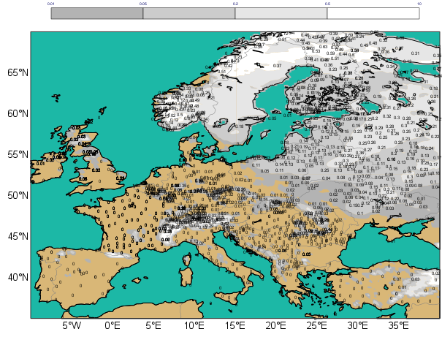
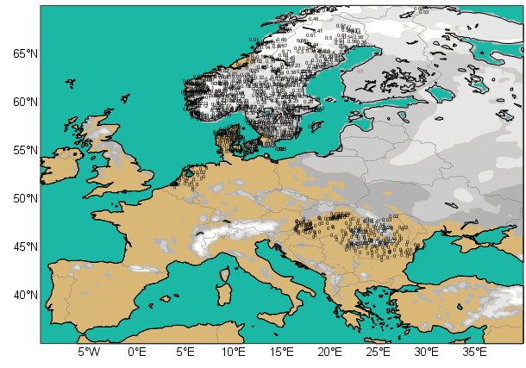
Snow Observations
Snow SYNOP and National Network data in Europe
Snow
Depth (cm)
5 20 50
Available on the GTS (Global Telecommunication System)
SYNOP
2016 01 15 at 06UTC
National Networks
Snow data
Additional data from national networks from up to 7 countries:
Sweden, Romania, The Netherlands, Denmark, Hungary, Norway, Switzerland.
Dedicated BUFR for additional national data
(de Rosnay et al. ECMWF Res. Memo, R48.3/PdR/1139, 2011)
Notes:
17

Slide 18
Snow depth observations
GTS Snow depth availability
SYNOP TAC + SYNOP BUFR + national BUFR data
Status on 5 February 2017
- Gaps in USA, China and southern hemisphere
- NRT data exist and is available (more than 20000 station in the USA), but it is not on the GTS for NWP applications.
- However, we note an improvement in China (since status in de Rosnay et al, ECMWF NL article 143, 2015)

Slide 19
Initiatives relevant to address snow observations
availability on the Global Telecommunication System (GTS)
GCW Snow Watch Activity
COST action on Snow: HarmoSnow
“A European network for a harmonised monitoring of snow for the benefit of climate change scenarios, hydrology and numerical weather prediction”.
Snow Watch reporting Handout 2015 (ECMWF/UKMO)
http://www.cost.eu/COST_Actions/essem/Actions/ES1404
http://costsnow.fmi.fi/
http://globalcryospherewatch.org/reference/documents/
New section for in situ surface data
Relevant to use it to monitor
snow depth data availability
- But empty search results for snow

Slide 20
Snow summary
Gaps in in situ SD reporting, but additional National data contribute to improve near surface weather forecasts
Nat. Met services encouraged to report snow depth on the GTS
Contributions from Snow Watch(WMO BUFR), HarmoSnow COST action (Questionnaire, inventory), GODEX-NWP (US issue), OSCAR (great potential for monitoring SD report availability)

